Slide 1
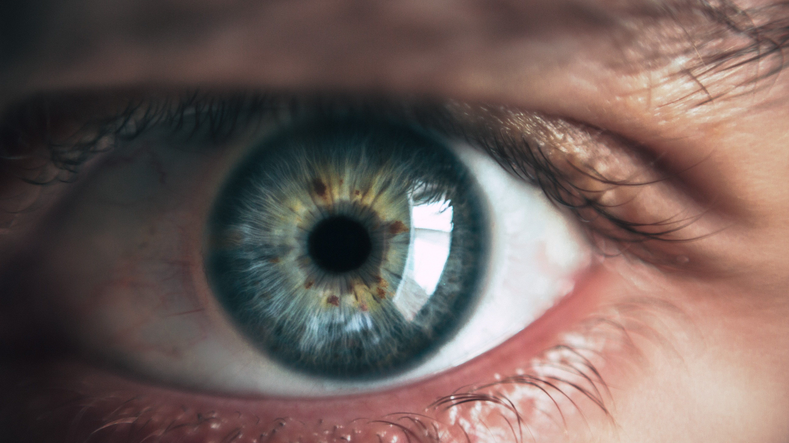
Daniela Matinho | Hanna Kerr | Yuling Gu
Blindness
Detection
Machine Learning
Fall 2019

Slide 2
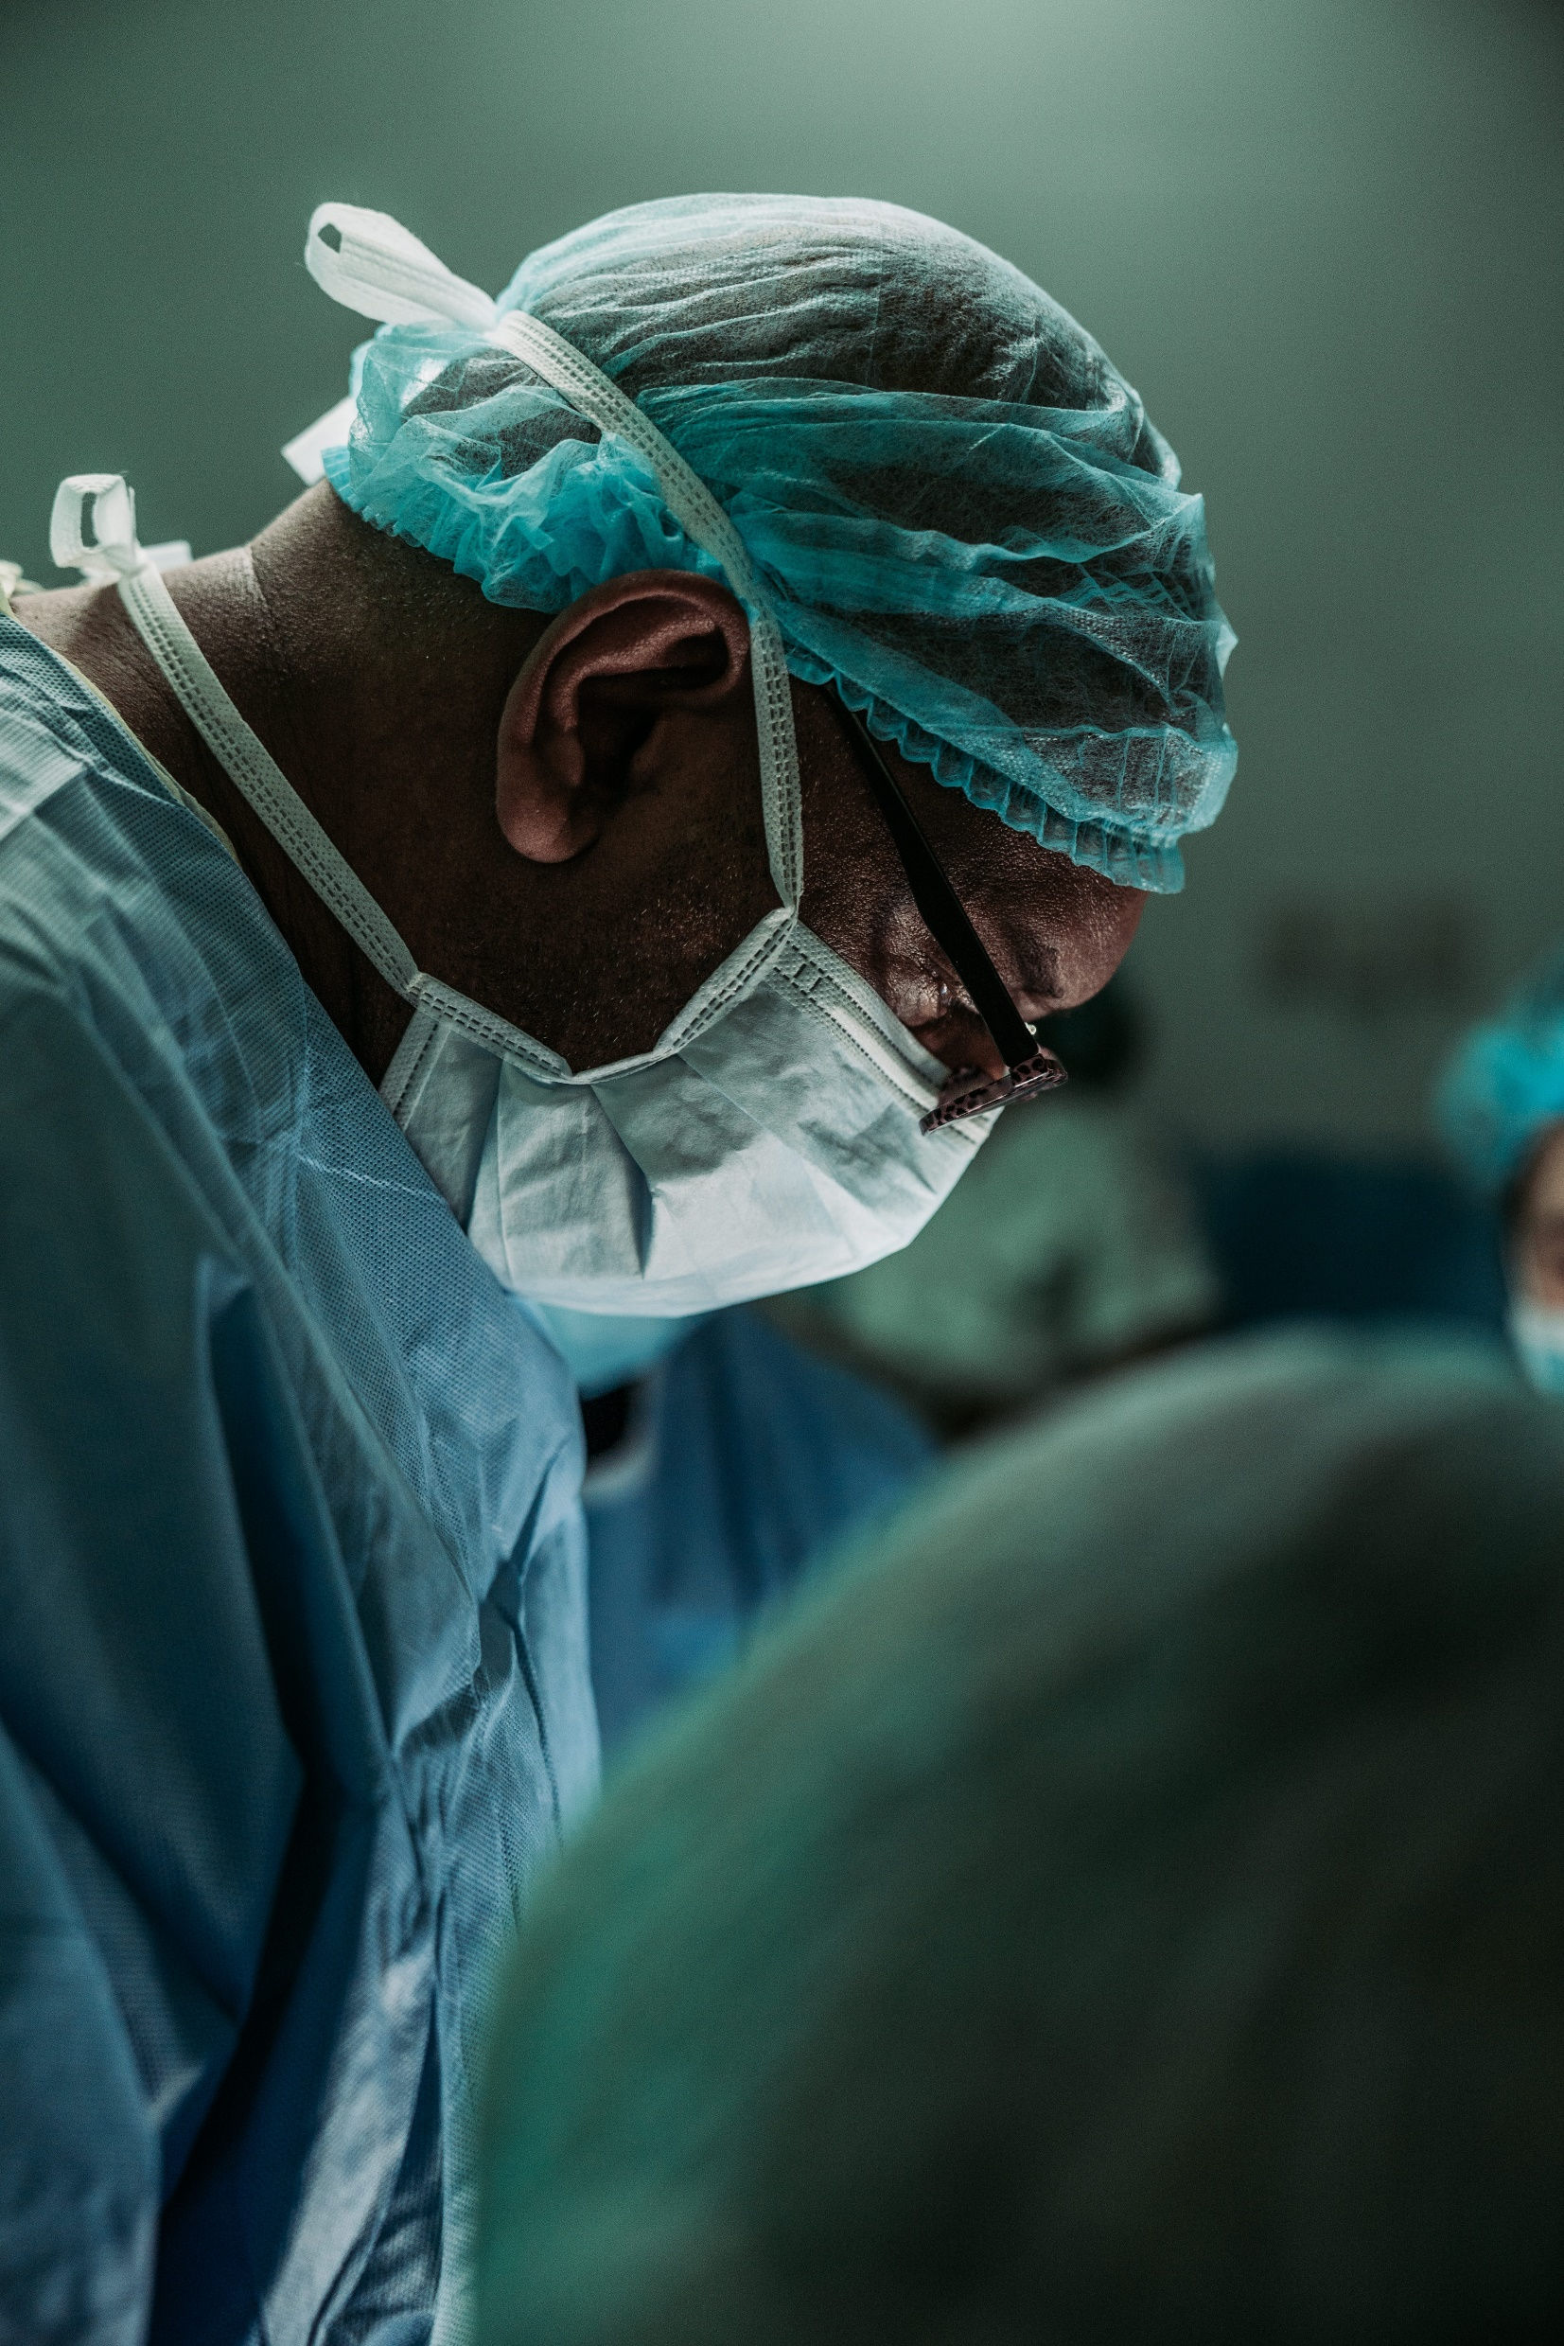

Blindness detection
Problem Statement
Data preprocessing
Machine Learning techniques:
PCA
Logistic Regression
Random Forest
ada - boost
Artificial Neural Networks:
Convolutional neural networks
Transfer Learning
Findings & Future Work
AGENDA

Slide 3
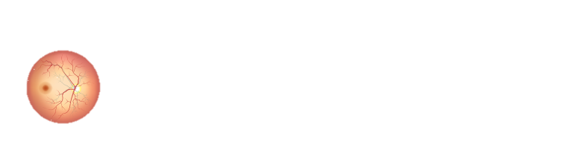
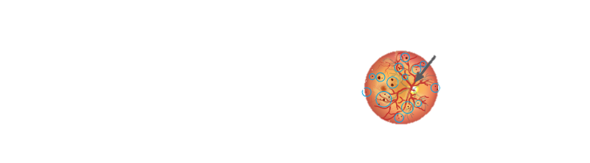
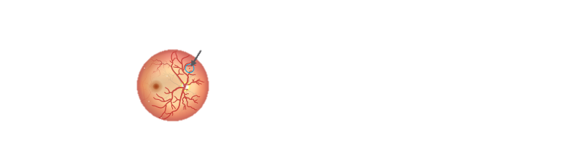
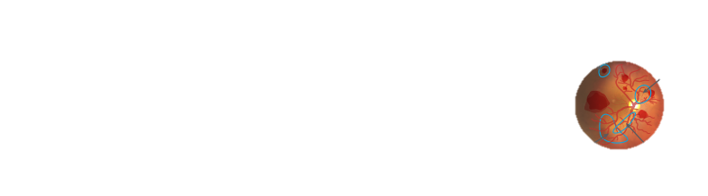

Stages of diabetic retinopathy
Sausaging
Blood Vessels
Diabetic retinopathy is the most common cause of vision impairment and blindness. It is caused by damage to the blood vessels of the light-sensitive tissue at the back of the eye (retina).
From 2010 to 2050, the number of diabetic retinopathy is expected to nearly double, from 7.7m to 14.6m in the US.
Normal
Micro-aneurism
Problem Statement
Severe
Bleeding
New Blood
Vessels
Mild
The purpose of this project is to correctly classify the five stages of the disease, given the images of different patients.
Detached
Retina
Scar Tissue
Proliferative
Moderate

Slide 4
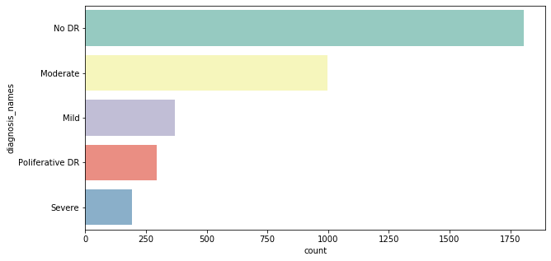
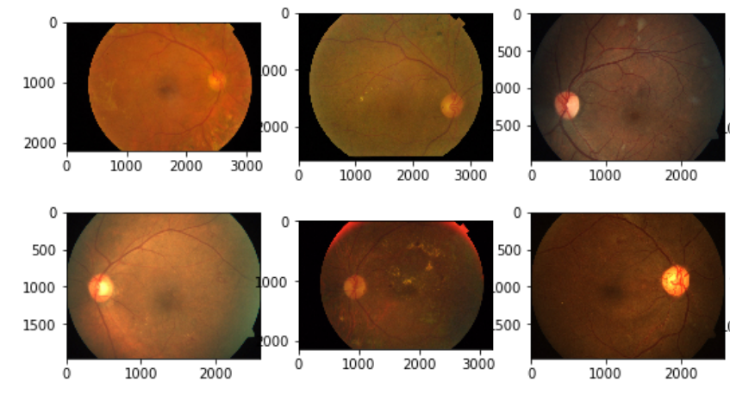
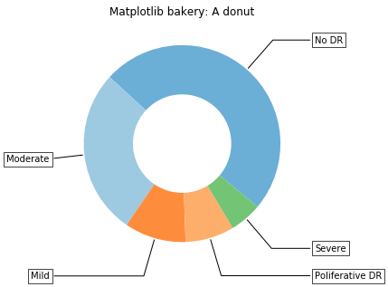
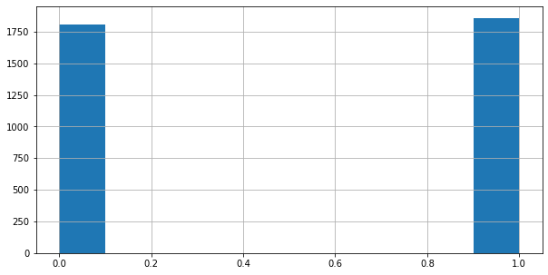
2. Exploratory Analysis
Stages of
Project
1. Data Collection
1805 images are not classified in the dataset (No DR)
Total of 3662 images
Data is pretty balance when we look at DR and No DR

Slide 5
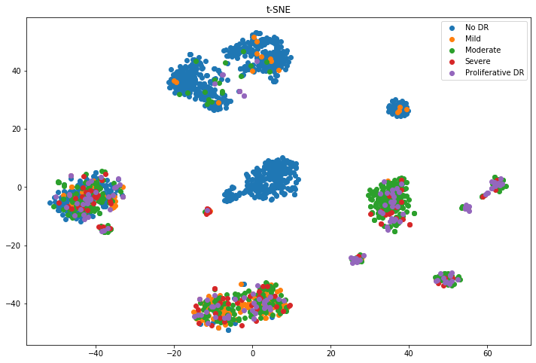
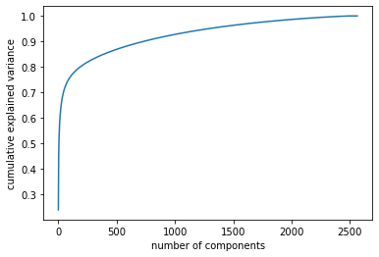
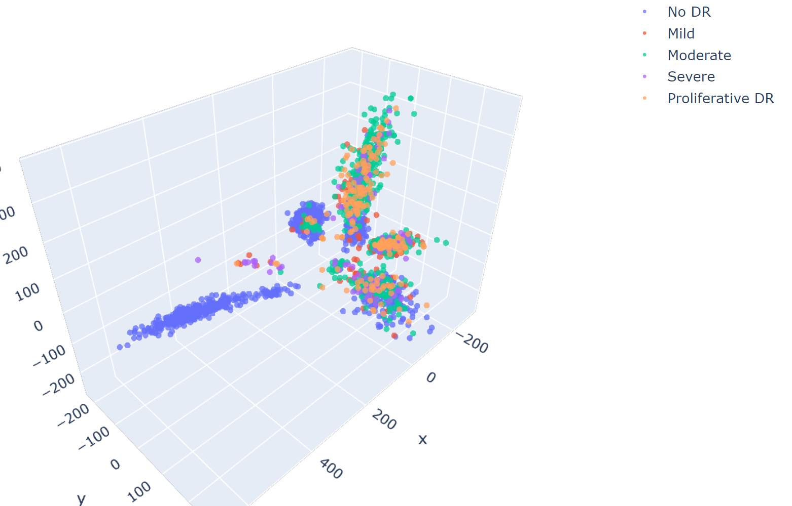
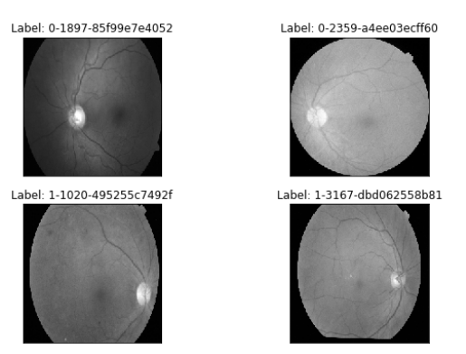
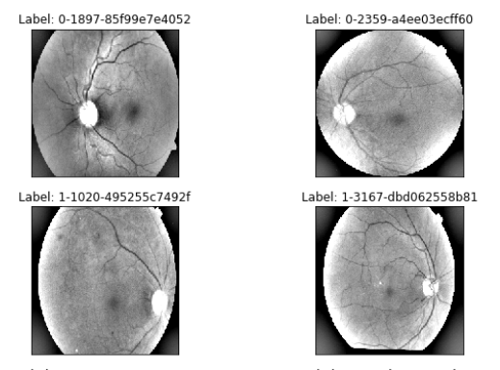
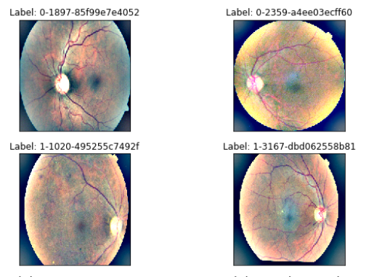
4. T-SNE & PCA
Stages of Project
3. Feature Engineering
T-SNE to see the distribution of the data
1
1
Standardize the data
Apply PCA
2
3
Reduce components from 750 out 2563 in 3D

Slide 6
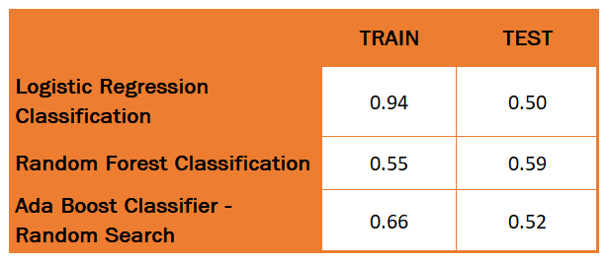
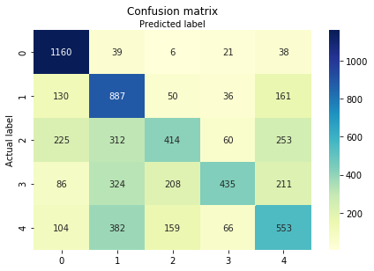
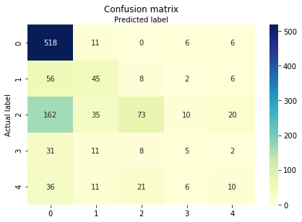
Machine Learning
1. Logistic regression Classification
2. Random FOREST Classification
3. ADA BOOst Classifier – RANDOM SEARCH
ASSUMPTIONS:
Data split: 70/30
Flatten data
Standardize - Reduce components to750
Smote the data
Fit three machine learning models
Tune models
TEST
The model has more difficulties
in classifying Moderate and No DR
classes
TRAIN

Slide 7
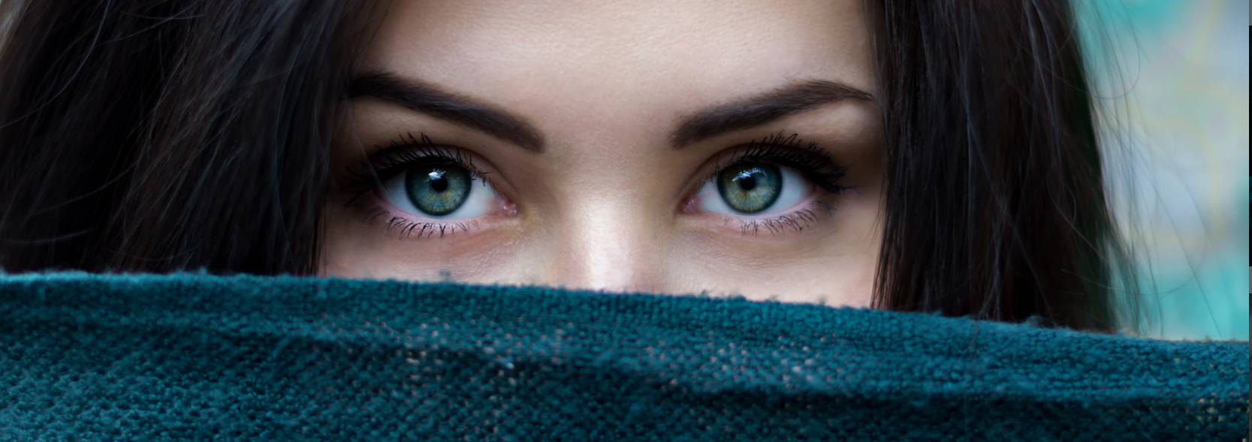
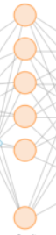
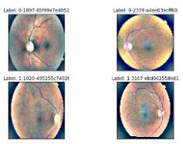
Convolutional Neural Networks
0 – No DR
1 – Mild
2 – Moderate
3 – Severe
4 – Proliferate
FULLY
CONNECTED
RELU
FLATTEN
RELU
Softmax
Input 225x225x3
RELU
FULLY
CONNECTED
CONVOLUTION | DENSE | MAXPOOLING | PADDING | DROPOUT LAYERS
Total number of layers: 15

Slide 8
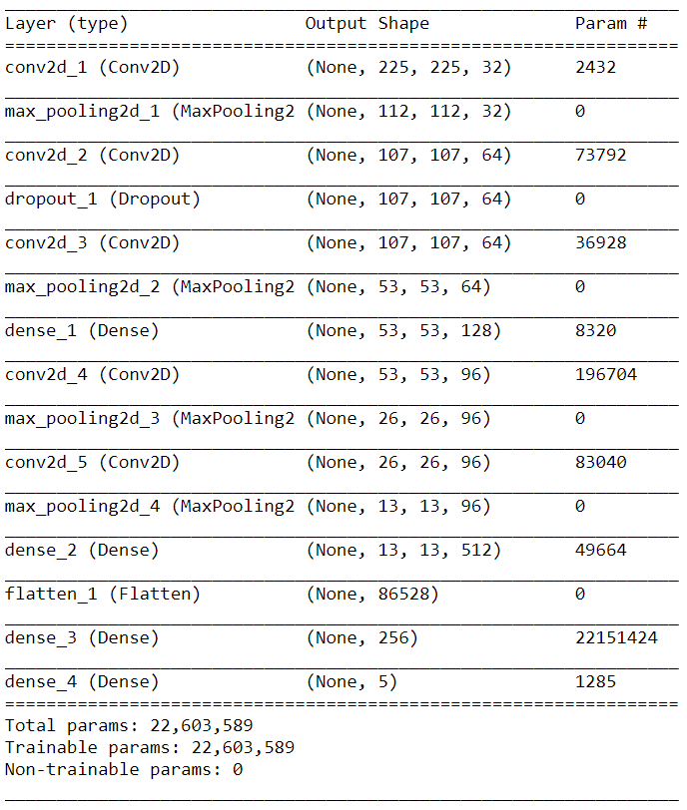
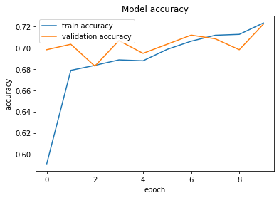
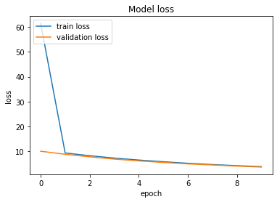
1. Build Basic CNN
Convolutional Neural Networks
Accuracy Train: 72.3% | Accuracy Test: 73.7%

Slide 9
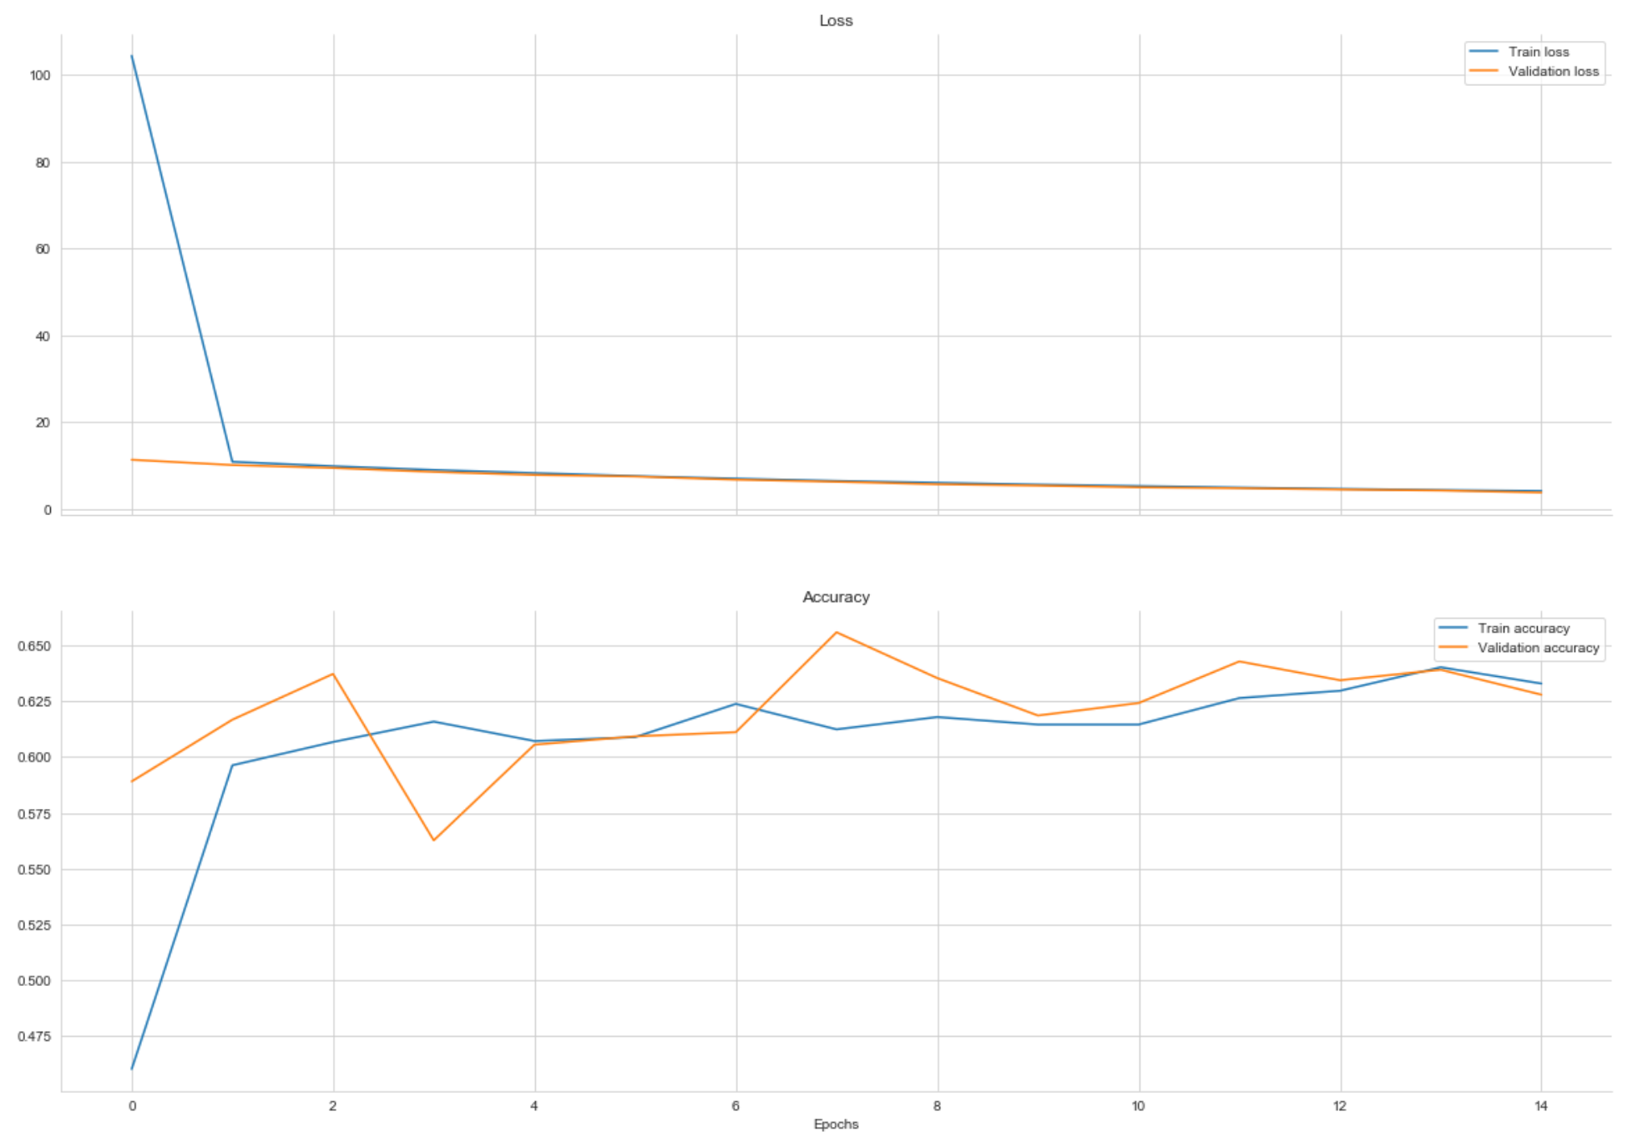
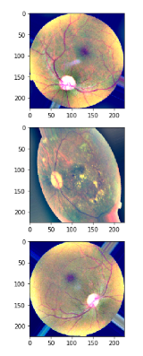
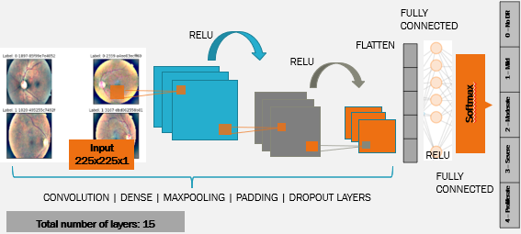
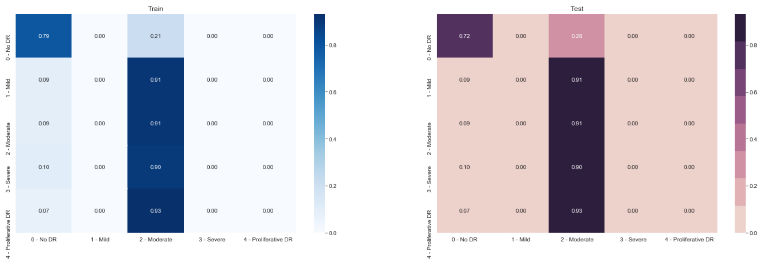
2. Build CNN With
Data Augmentation
Convolutional Neural Networks
3
2
1
ASSUMPTIONS:
Data Augmentation: horizontal flip,
width shift (0.2), zoom (0.1)
Data validation split: 0.2
Callbacks: early stopping
Batch size: 50 | Epochs: 15
Accuracy Train: 64.8%
Accuracy Test: 69.8%

Slide 10
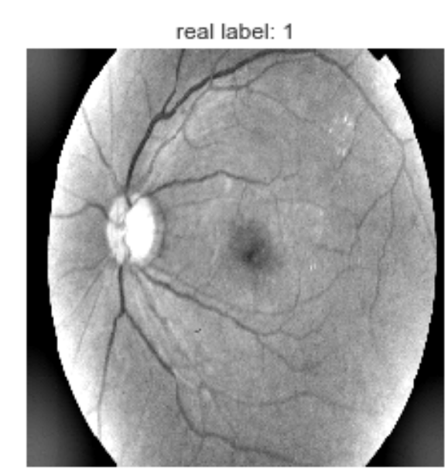
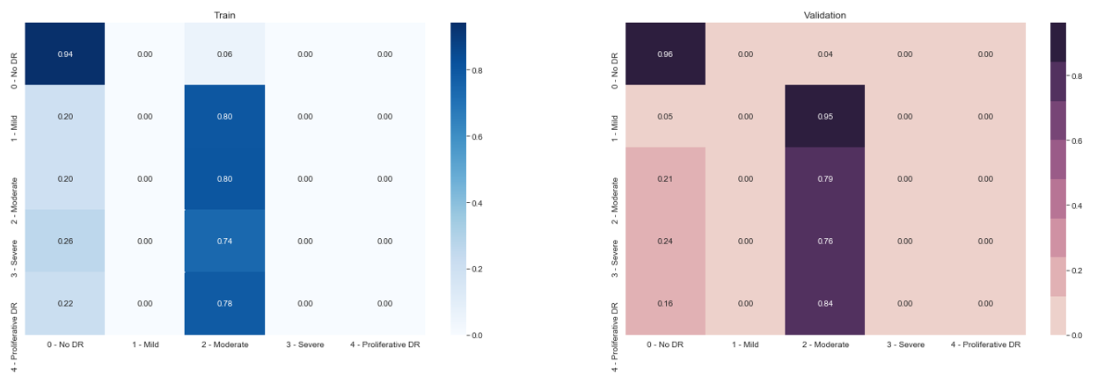
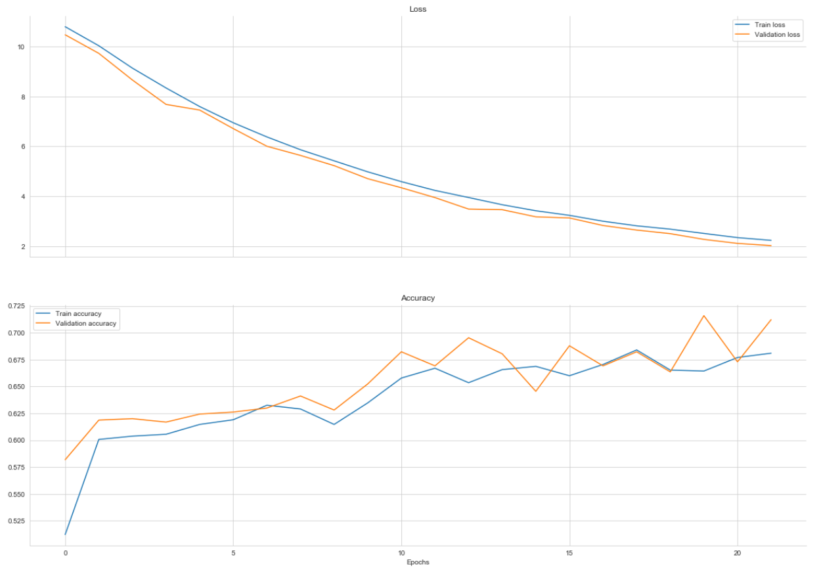
Convolutional Neural Networks
3. Build CNN With
Data Augmentation &
TEST Time AUGMENTATION
1
3
2
Batch size: 60 | Epochs: 20
Accuracy Train: 68.1%| Accuracy Test: 70.7%

Slide 11
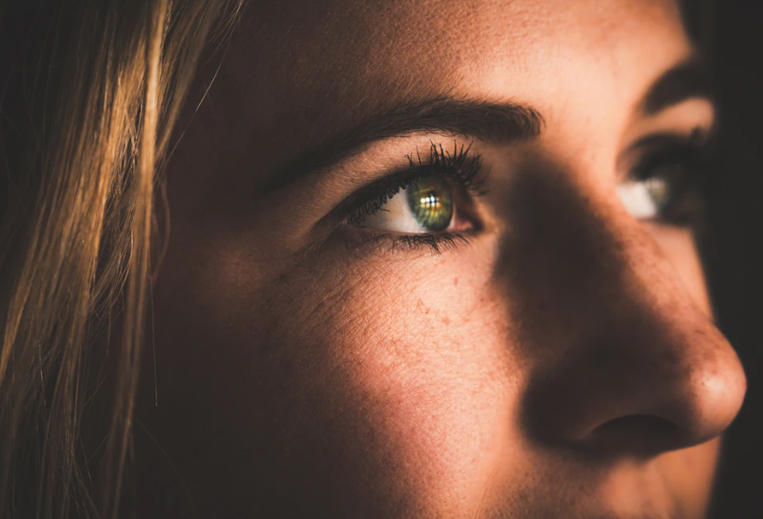
Transfer Learning
225X225X3
Conv3x3
MBConv1 3x3
MBConv6 3x3
STAGE 5
STAGE 2
STAGE 4
STAGE 3
STAGE 1
MBConv6 3x3
ID
BLOCK
x2
ID
BLOCK
x2
ID
BLOCK
x5
AVG
POOL
ID
BLOCK
x3
CONV
BLOCK
ZERO
PAD
CONV
BLOCK
Batch
Norm
CONV
BLOCK
MAX
POOL
CONV
BLOCK
FC
CONV
Flatten
ReLU
MBConv6 5x5
Output
MBConv6 5x5
Input
Accuracy on the validation data set is 83% and on the test data set is 83%
EFFICIENTNETB0
Less parameters than others
Inverted bottleneck MBConv
Fewer channels & depth separable convolution
MBConv6 3x3
RESNET50
CNN trained with > 1m images
50 layers
Consist of 5 stages each with convolution and identity block
MBConv6 5x5
MBConv6 5x5
MBConv6 3x3
Output

Slide 12
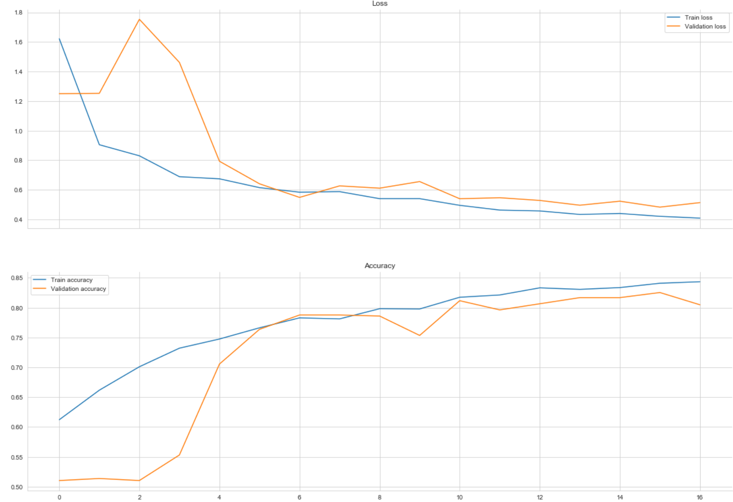
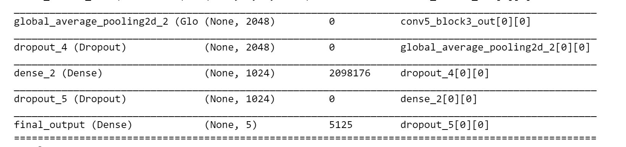
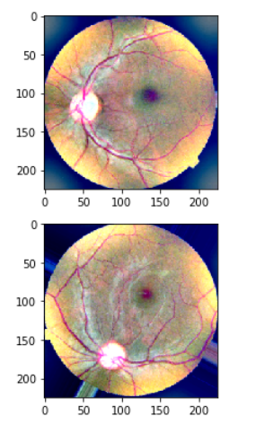
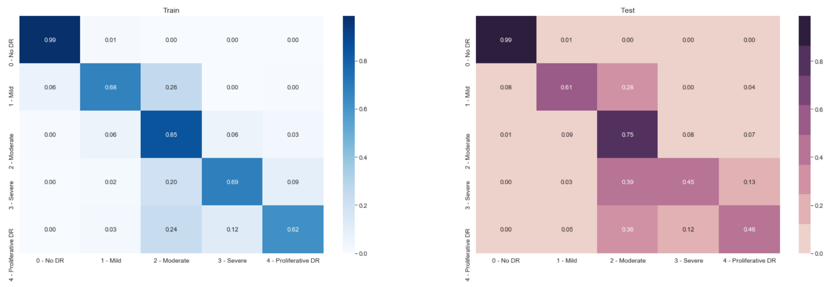
3. Results
Transfer
Learning
1. resnet50
2. Steps & tuning
Accuracy Train: 84.3%| Accuracy Test: 81.9%
Custom network
Freeze the model
Train the layers added
Unfreeze layers in base network
Joined train layers and part added

Slide 13
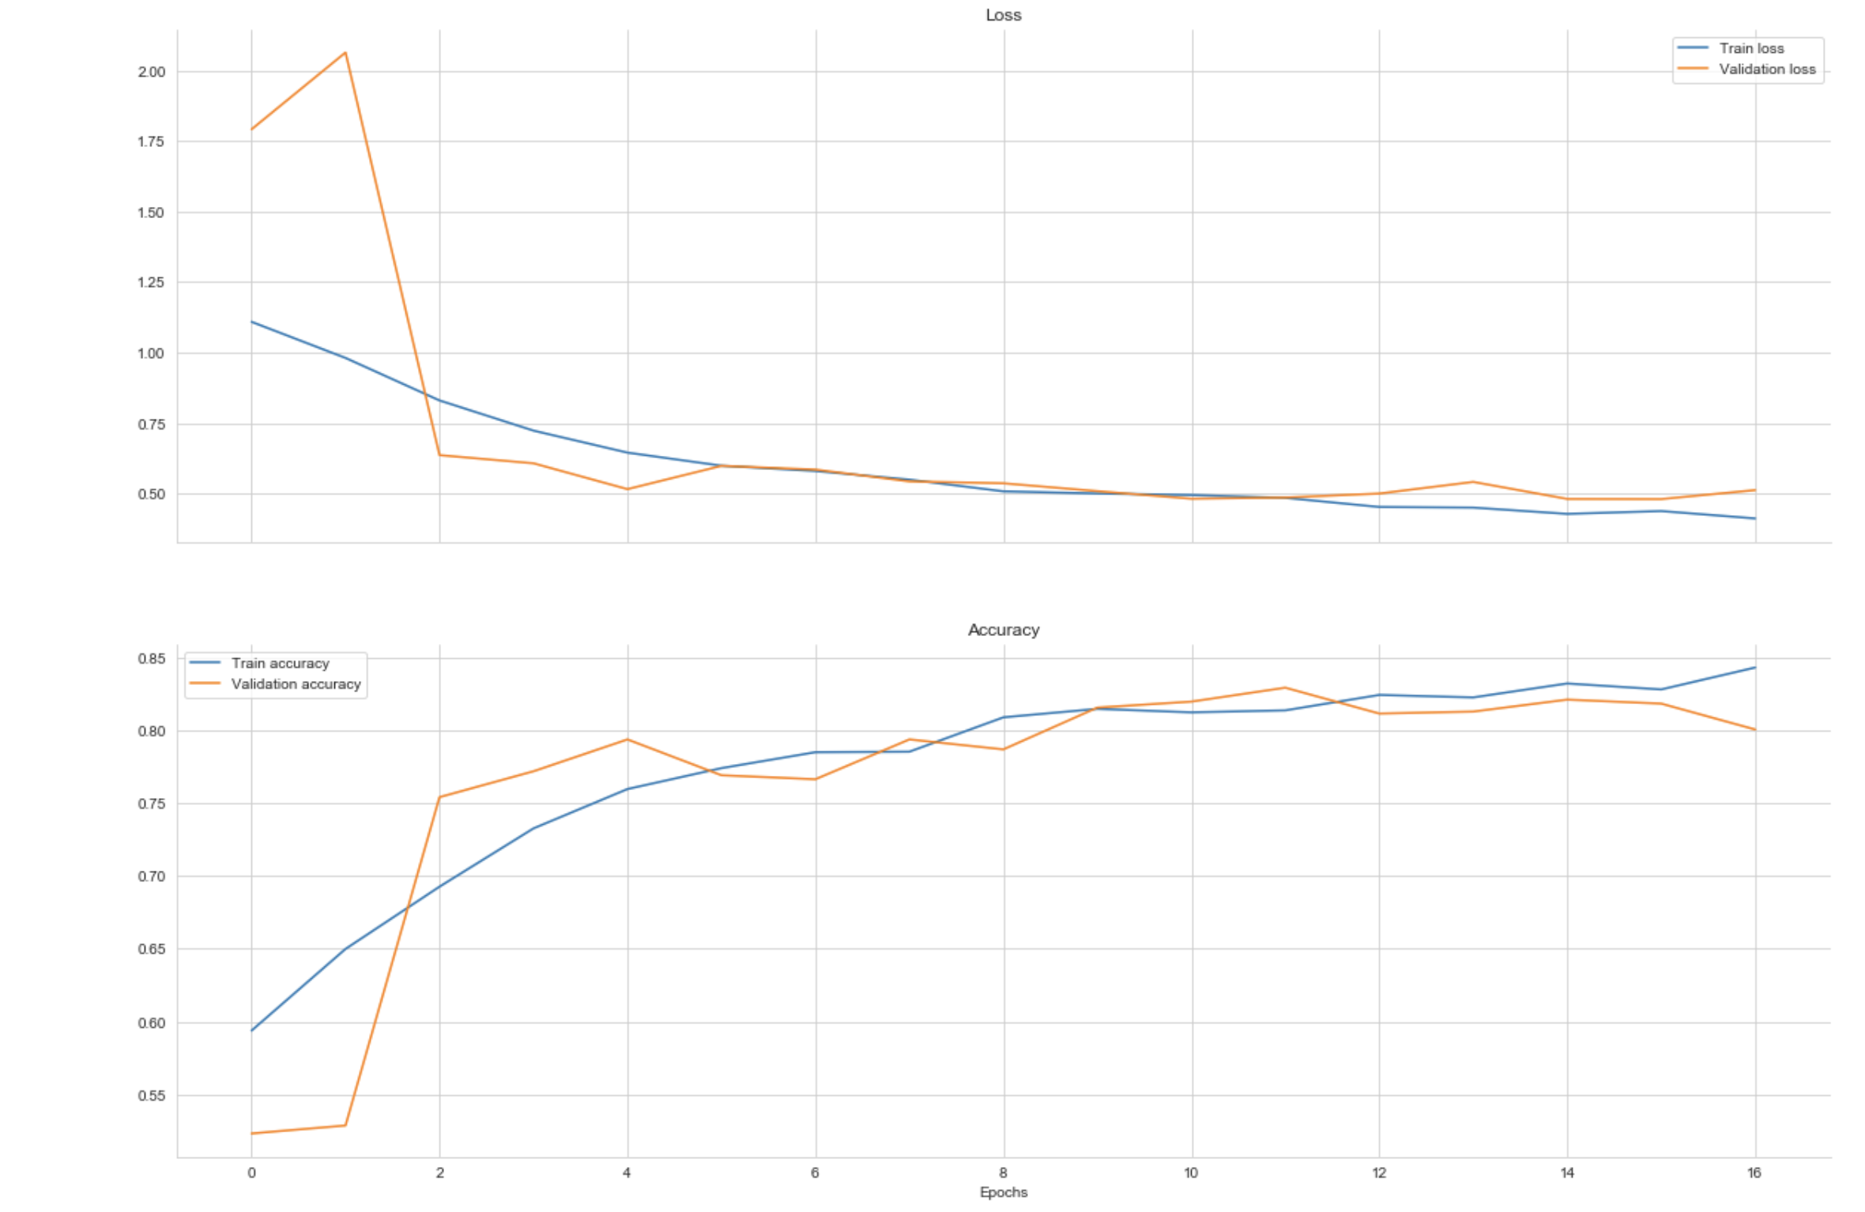
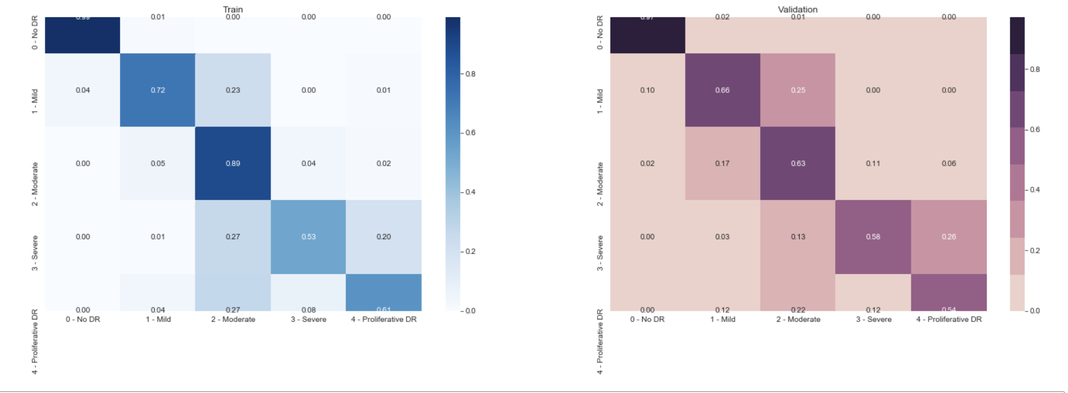
3. Results
Transfer
Learning
1. EFFICIENTNETB0
2. Steps & tuning
Accuracy Train 84.3% | Accuracy Test: 83.6%
Custom network
Freeze the model
Train the layers added
Unfreeze layers in base network
Joined train layers and part added

Slide 14

Future work
Findings
Use other data sets available for training
Use other parameters to tune models such as dropout
Use other activation and loss functions
We used Machine Learning algorithms to achieve 50% accuracy
We used Convolution Neural Networks to achieve 73% in accuracy
We used Transfer Learning achieving 84% accuracy, being the best score overall

Slide 15
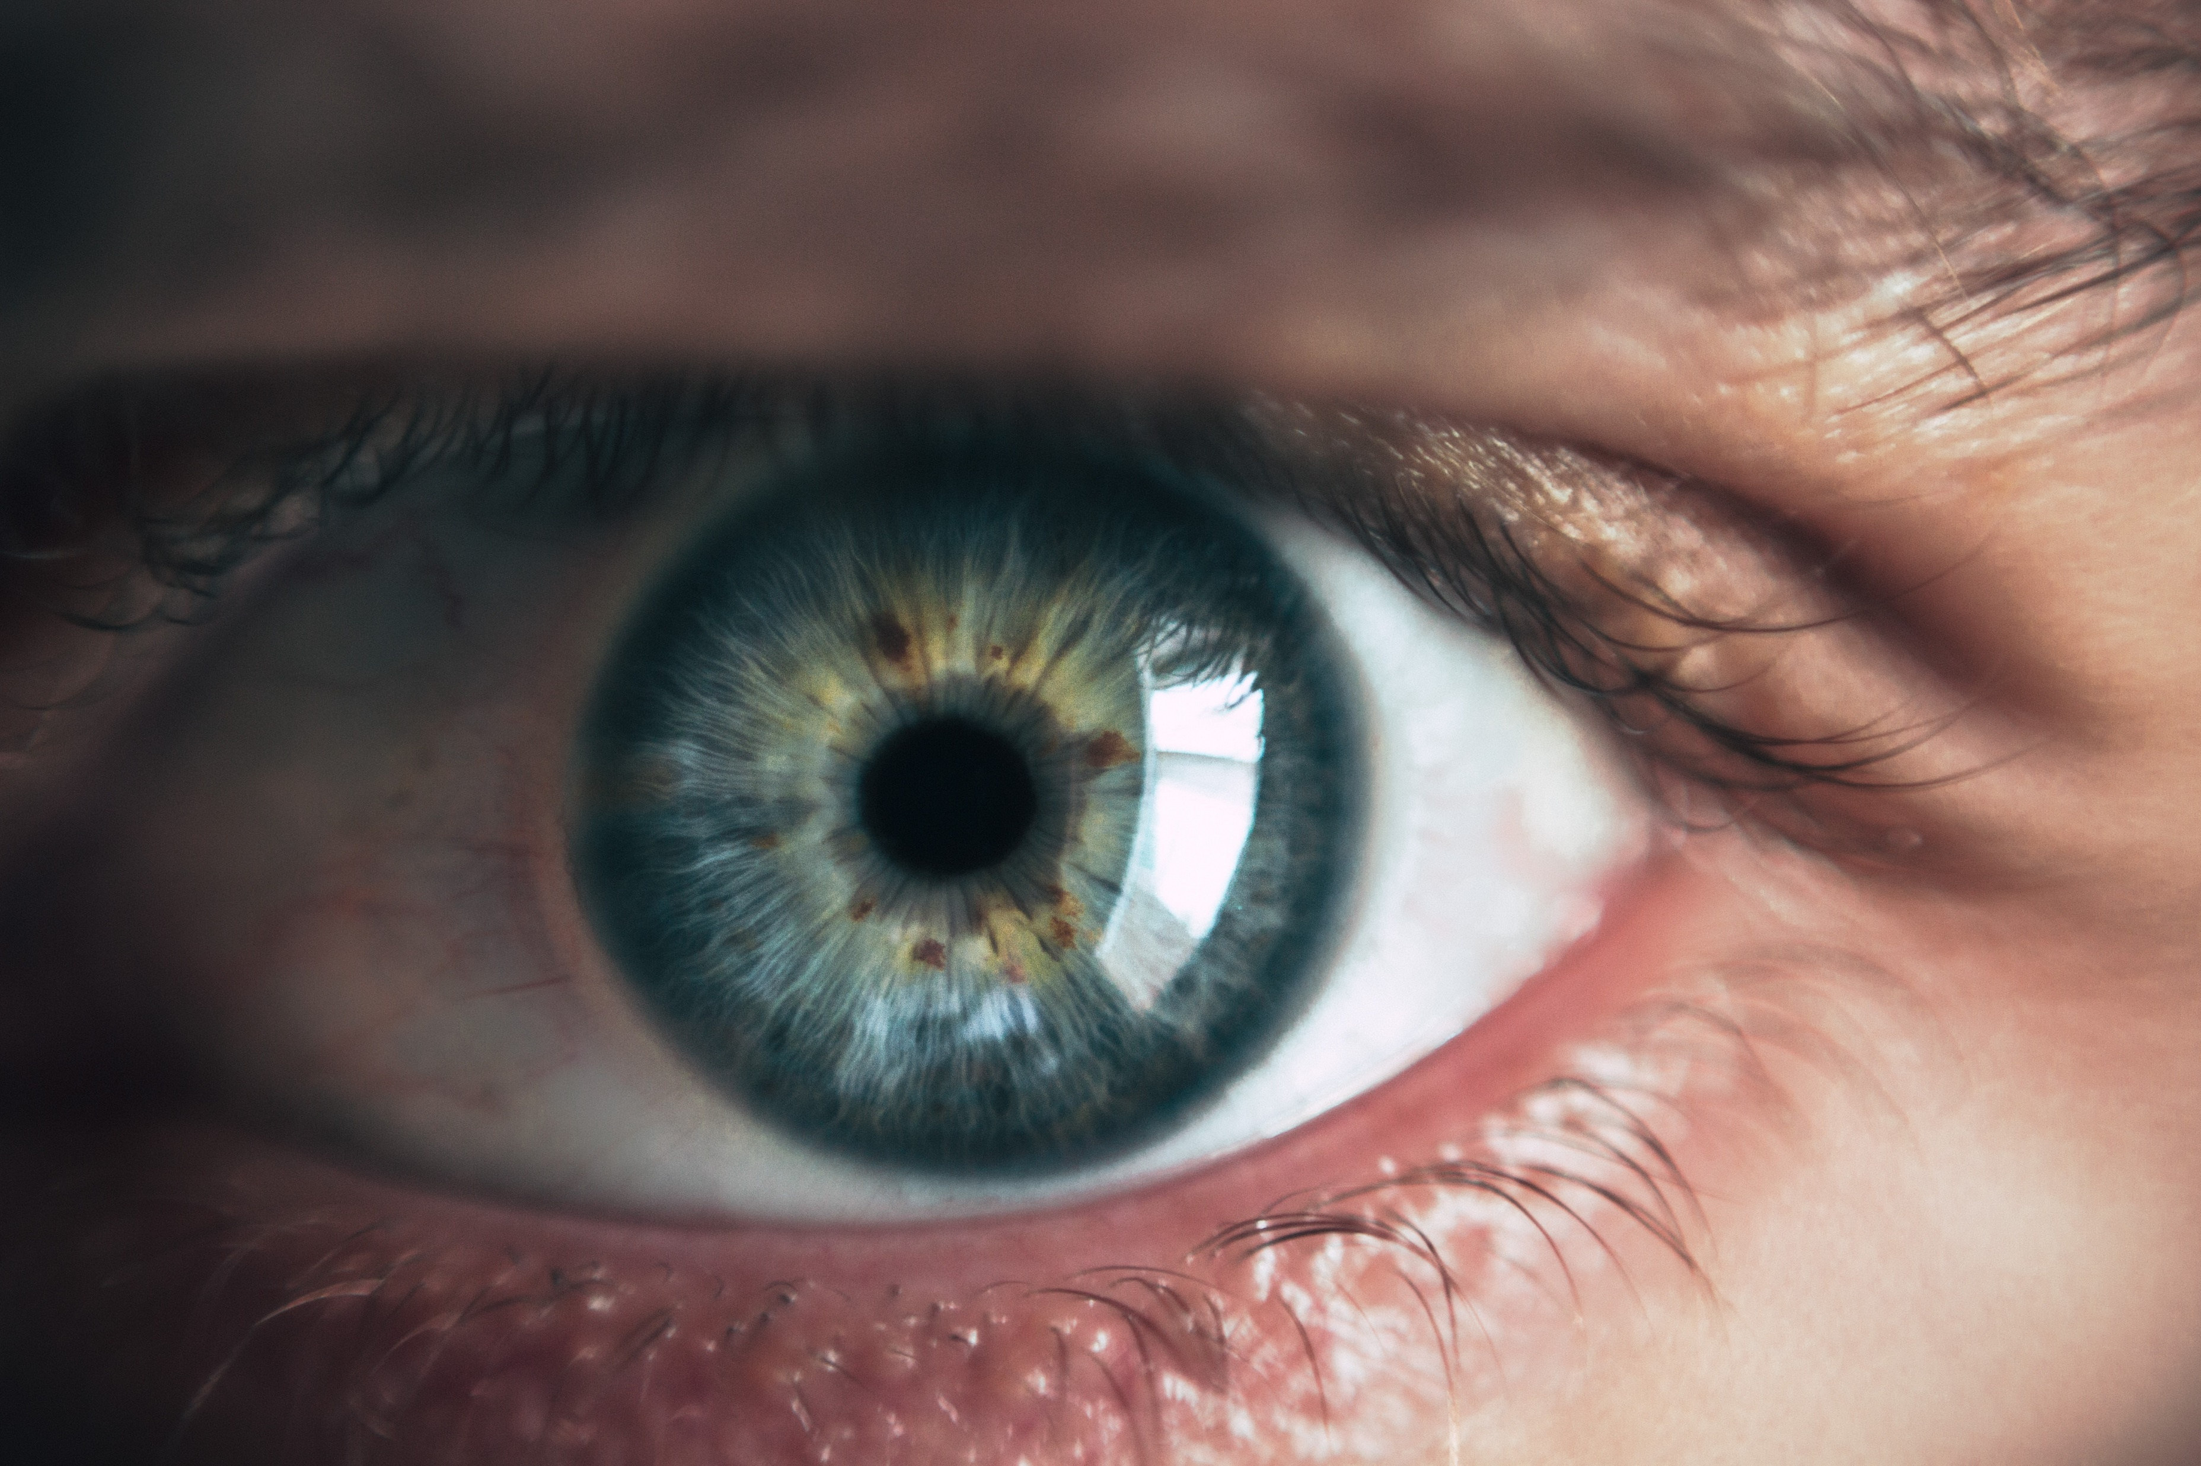



Thank You
Enjoy the break
Daniela Matinho
CNN models
Presentation
Hanna Kerr
Machine Learning models
Transfer Learning model
Yuling Gu
Exploratory analysis
Transfer Learning model

